Slide 1
Mechatronics
The Foundation for Manufacturing, Supply Chain Technology and other critical industries
October 24, 2013

Slide 2
Our Participants
Gary Forger SVP of Professional Development
William Mazurek, Director of Continuous Improvement
Marilyn Barger, Ph.D., P.E., CPT
Executive Director and PI
Florida Advanced Technological Education Center of Excellence
Ned D. Young, Ph.D. Co-PI The National Center for Supply Chain Technology Education

Slide 3
What is Mechatronics?
“Mechatronics is the synergistic combination of precision mechanical engineering, electronic control and systems thinking in the design of products and manufacturing processes. It relates to the design of systems, devices and products aimed at achieving an optimal balance between basic mechanical structure and its overall control.”
http://www.journals.elsevier.com/mechatronics/
AACC Mechatronics Video

Slide 4
Questions for the audience?
Does your institution have a mechatronics type program?
If so, what is it called?

Slide 5
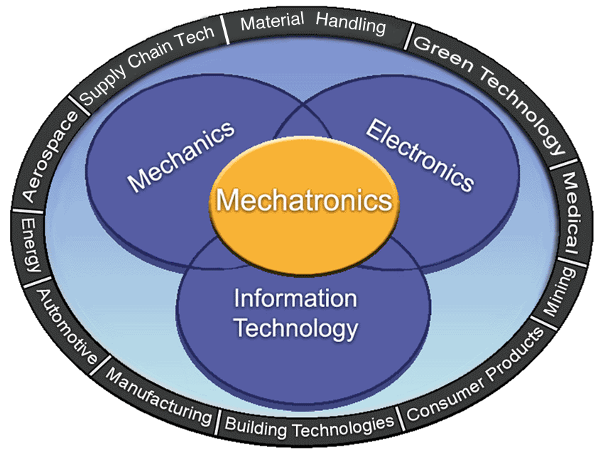
Mechatronics – An Integrative Discipline

Slide 6
Industry Sectors Requiring Mechatronics?
Material Handling: MHI/SCTE Video
Advanced Manufacturing: Flate Video
Packaging: Invata Video
Renewable Energy: Wind turbine Video

Slide 7
What type of employees have Mechatronics Skills?
In Material Handling?
In Production/Manufacturing?

Slide 8
Are there relevant industry certifications?
Siemens: Mechatronics Systems Certification
The Association for Packaging and Process Technologies (PMMI) Mechatronics Certificates

Slide 9
Questions for our Industry Partners
Are there other certifications?
How important are certifications?
Is an Associate degree of similar or equal value?

Slide 10
Questions for the audience?
Do your industry partners require certifications?
How important are the certifications?
Is an Associate degree of similar or equal value?

Slide 11
Mechatronics and the curriculum
How can industry specific awareness and mechatronic applications be included in an integrated curriculum?
Chattanooga State (auto)
St. Clair College (automation, energy)
Gateway Technical College (general)

Slide 12
Two Example Curricula
Advanced Manufacturing | Supply Chain Technology
Electrical Systems | AC/DC Theory and Service
Mechanical Systems | General Mechanics
Pneumatics and Hydraulics | Pneumatics and Hydraulics
PLCs | PLC Theory & Maintenance
Robotics | Math for eng. technology
Mechatronics Capstone | Technical communication
Electives (Choose 3)
High Tech Manufacturing | Introduction to automated warehousing
Manufacturing Processes
Eng. CAD and Drafting | Blueprint reading
Advanced PLC | Micro Processors & controls
Industrial Robotics
Industrial Safety | OSHA Safety standards
Welding | Welding

Slide 13
Mechatronics – An Integrative Discipline

Slide 14
Let’s Discuss
Other ideas how industry specific awareness and applications be included in the curriculum? Examples of strategies that have worked?

Slide 15
Concluding thoughts…
Mechatronics is a growing skill set These skills are transferable across many industries
Educational institutions must better understand how these skill sets can be integrated in curricula offerings

Slide 16
Contact us:
Gary Forger GForger@mhi.org
William Mazurek bmazurek@linvatec.com
Marilyn Barger, Ph.D., P.E., CPT
mbarger@hccfl.edu
Ned D. Young, Ph.D. ned.young@Sinclair.edu

Slide 17
This work was partially funded by NSF grants DUE 1104176 and DUE 0802436.
Any opinions, findings, conclusions or recommendations presented are only those of the presenter grantee/researcher, author, or agency employee; and do not necessarily reflect the views of the National Science Foundation.

