Slide 1


MECHATRONICS
Delivering industry relevant mechatronics training and education for high tech business sectors
AACC April 2014

Slide 2



Our Team
Marilyn Barger, Ph.D., P.E., CPT
Executive Director and PI
Florida Advanced Technological Education Center of Excellence
www.fl-ate.org
Ned D. Young, Ph.D.
Co-PI
The National Center for
Supply Chain Technology Education
www.supplychainteched.org
Partners with Industry for a New American Workforce

Slide 3
What is Mechatronics?
“Mechatronics is the synergistic combination of precision mechanical engineering, electronic control and systems thinking in the design of products and manufacturing processes. It relates to the design of systems, devices and products aimed at achieving an optimal balance between basic mechanical structure and its overall control.”
http://www.journals.elsevier.com/mechatronics/
AACC Mechatronics Video

Slide 4
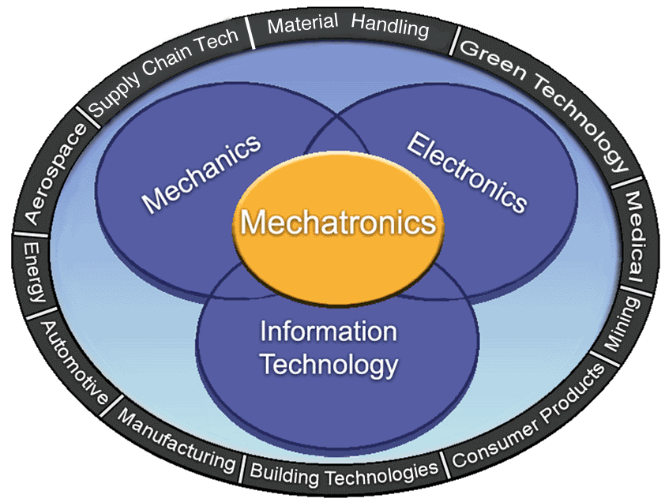
Mechatronics – An Integrative Discipline

Slide 5
Questions for the audience?
Does your institution have a
mechatronics type program?
If so, what is it called?
How many credits?
Where is it housed in your academics?

Slide 6
Sample program names from survey
Program Title
Advanced Manufacturing | 1
Applied Integrated Technology | 1
Automation Electronic Technology | 1
Computer Integrated manufacturing | 1
Electrical Engineering | 2
Engineering Technology | 2
Mechatronics Technology | 17
Robotics | 1

Slide 7
Mechatronics Industry Sectors
Material Handling/: MHI/SCTE Video
Supply Chain Tech: Skechers Video
Production/
Manufacturing: TrankTek Video
Packaging: Invata Video
Renewable Energy: Wind turbine Video

Slide 8
Are there relevant industry certifications?
Siemens: Mechatronics Systems
Certification
The Association for Packaging
and Process Technologies (PMMI)
Mechatronics Certificates
MHI/MSSC/SCTE working on a
Supply Chain Technician certification

Slide 9
Questions for the audience?
Do your industry partners require
certifications (in any disciplines)?
How important are the certifications?
Is an Associate degree (A.S./A.A.S.) of similar or equal value?

Slide 10
Industry defined skills gaps
GlobalFoundries (Malta, NY)
The National Center for Supply Chain Technology Education (SCTE) and the California Centers of Excellence (COE) research study

Slide 11
College Self-assessments summary, Skills 1 – 11
GLOBALFOUNDRIES, Malta, NY
 | Skill Category | GF’s Needs | CC Stats
1 | Implementing Quality Principles | 3 | 1.56
2 | Demonstrating Working Knowledge of Basic Electronics | 3 | 2.44
3 | Operating Equipment | 1 | 1.50
4 | Processing Wafers | 1 | 0.56
5 | Troubleshooting and Repairing Electrical/Electronic Equip. | 3 | 2.13
6 | Troubleshooting and Repairing Pneumatic Systems | 3 | 1.00
7 | Troubleshooting and Repairing Hydraulic Systems | 3 | 0.63
8 | Troubleshooting and Repairing Electromechanical Systems | 3 | 1.13
9 | Troubleshooting and Repairing Vacuum Systems | 3 | 0.88
10 | Troubleshooting and Repairing RF Systems | 3 | 1.25
11 | Operating Remote Systems | 1 | 1.00
Skill Gaps

Slide 12
Results of College Self-assessments, Skills 12 - 22
College Self-assessments summary, Skills 11-22
GLOBALFOUNDRIES, Malta, NY
Skill Gaps
 | Skill Category | GF’s Needs | CC Stats
12 | Perform Preventive and Routine Maintenance | 3 | 1.69
13 | Maintain Automated Systems | 3 | 0.56
14 | Implementing Manufacturing Technology and Techniques | 1 | 0.63
15 | Utilizing Computers | 3 | 3.00
16 | Adhering to Basic Safety Practices | 3 | 0.94
17 | Applying Scientific Fundamentals | 2 | 1.13
18 | Performing Mathematical Calculations | 3 | 2.19
19 | Recognizing Workplace Fundamental Principles | 3 | 1.63
20 | Using Information Skills | 3 | 2.50
21 | Employing Interpersonal Skills | 3 | 2.25
22 | Displaying Appropriate Personal Qualities | 3 | 2.25

Slide 13
SCTE / COE STUDY
Current employment for Supply Chain Technicians estimate: 203,000
Employers surveyed project an increase of 30% in 24 months.
Equates to 61,000 additional jobs.
Variability in skill, education, and certification requirements reported by respondents is warranting a model curriculum to be developed and shared with the community colleges nationwide
Four functional skill areas confirmed by employers: operate equipment, maintain equipment, direct maintenance, and maintain systems

Slide 14
SCTE / COE STUDY (continued)
Five areas of expertise have been identified for Supply Chain Technicians
It is not enough for a technician to be proficient in just one area

Slide 15
Mechatronics Curriculum & Skills
(courses between disciplines are not intended to demonstrate equivalency)
FSCJ – Manufacturing Focus | SCTE – Supply Chain Technology focus
Electrical Systems | AC/DC Theory and Service
Mechanical Systems | General Mechanics
Pneumatics and Hydraulics | Pneumatics and Hydraulics
PLCs | PLC Theory & Maintenance
Robotics | Math for eng. technology
Mechatronics Capstone | Technical communication
Electives (Choose 4)
High Tech Manufacturing | Introduction to automated warehousing
Manufacturing Processes
Eng. CAD and Drafting | Blueprint reading
Advanced PLC | Micro Processors & controls
Industrial Robotics
Industrial Safety | OSHA Safety standards
Welding | Welding
SIDE BY SIDE mfg/material handling
MARILYN

Slide 16
What we’ve learned …
Discovered WHY industry values Mechatronics-like Skills, Knowledge and Abilities
Described what a mechatronics technician does in the workplace
Presented educational approaches to developing mechatronics programs
Examined best practices for Mechatronics programs
Considered what Industry looks for in today’s technicians (industry does not necessarily embrace the term “mechatronics”)

Slide 17
Concluding thoughts…
Mechatronics is a growing skill set
These skills are transferable across
many industries
The term “mechatronics” may be confusing to industry
Educational institutions must better understand how these skill sets can be integrated in curricula offerings

Slide 18
Contact us:
Marilyn Barger, Ph.D., P.E., CPT
mbarger@hccfl.edu
http://www.fl-ate.org/
Ned D. Young, Ph.D.
ned.young@Sinclair.edu
http://www.supplychainteched.org/

Slide 19
This work was partially funded by NSF grants
DUE 1104176 and DUE 0802436.
Any opinions, findings, conclusions or recommendations presented are only those of the presenter grantee/researcher, author, or agency employee; and do not necessarily reflect the views of the National Science Foundation.

Slide 20


www.highimpact-tec.org
Join Us in Chicago, IL!
July 21-24, 2014

