Slide 1

ATE Careers for Veterans: Discharge Planning and the Civilian ATE Workforce
Ned D. Young, Ph.D.
Co-PI National Center for Supply Chain Automation
Ned.young@Sinclair.edu

Slide 2


Our Environment
The E-Commerce Revolution has increased on-line shopping
Consumers want their purchases ASAP
Retailers, shippers, and expediters are turning to automation to meet customer expectations

Slide 3

Our Problem
Automated warehouses and distribution centers require higher-level skill sets (not unskilled pick/pack)
Technicians install, operate, support, upgrade or maintain the automated material handling equipment
Optical scanners, Automated Storage and Retrieval Systems (ASRS), programmable logic controllers (PLCs), conveyor systems, sensors and robotics.

Slide 4

Our Second Problem
Higher level automation skills require higher level employees
Employers can’t find enough skilled workers for job openings (projected openings between 2015-2025: 770,000)
There are not enough high school and community college students graduating with necessary skills

Slide 5
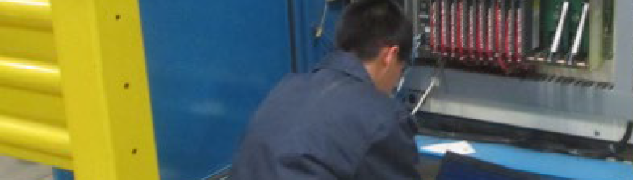
Our Model Program

Slide 6
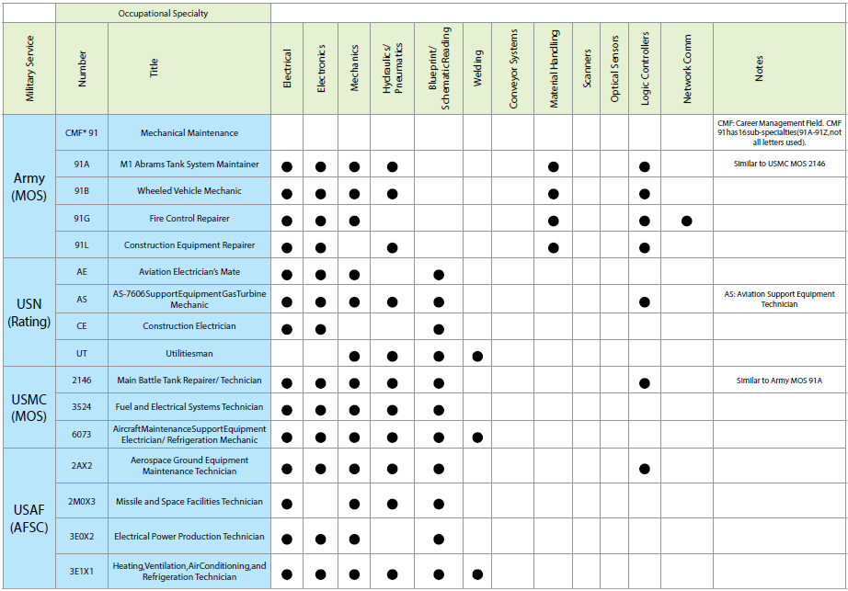
One Solution - Veterans

Slide 7
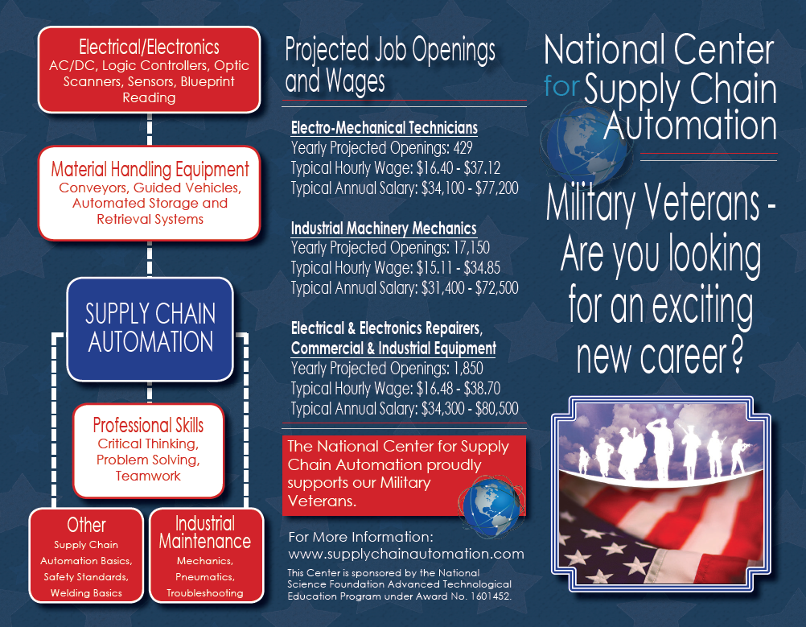

Slide 8
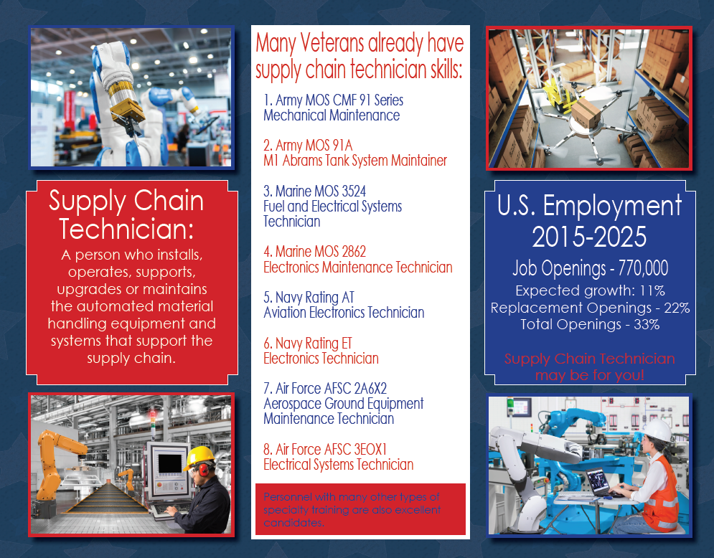

Slide 9
Next Steps
Using National databases such as the American Council on Education’s (ACE) Military Guide and
State databases such as Ohio’s Military Transfer Assurance (MTAG) guide
Create specific articulated transfer credit recommendations that connect military occupations and course work with SCT Model Program courses to be shared with our education network.

Slide 10
An Example
ACE ID Course | Course Number | Name of the Military Training, Experience, and Coursework | Effective Date | Course Alignments with Current Statewide Course/Program Equivalency Guarantees | Sinclair Equivalency | Credit Hours
AR-1704-0223 v5 | 602-15F10 | UH-60/CH-47 HELICOPTER ELECTRICIAN | 10/15– Present | OET001 DC Circuits OET003 AC Circuits | EET 1150 EEET 1155 | (4) (3)
AR-1715-0971 v3 | 198-94Y10 | Integrated Family Test Equipment Operator/Maintainer | 10/11– Present | OET001 DC Circuits OET002 Digital OET004 Microprocessors OET005 Electronics | EET 1150 EET 1131 EET 2261 EET 2201 | (4) (5) (4) (5)

Slide 11

The National Center for Supply Chain Automation
www.supplychainautomation.com
Ned D. Young, Ph.D.
Co-PI
Sinclair Community College
(937) 512-2759
Ned.young@Sinclair.edu
This Center is sponsored by the National Science Foundation’s Advanced Technological Education Program under Award No. 1601452. Any opinions, findings, conclusions or recommendations presented are only those of the presenter grantee/researcher, author or agency employee and do not necessarily reflect the views of the National Science Foundation.

